Slide 1
Robotics Kinematics
BRAC University

Slide 2
Forward Kinematics
Method 1: Using Trigonometric Process (Previous Class)
Limitations:
Becomes Complicated for Multiple Links
Not Systematic (Depends on geometry insight, Requires manual thinking every time, No fixed procedure)
Hard to Generalize (Change joint orientation: re-derive everything again)
etc ….

Slide 3
Forward Kinematics
Method 2: Using Homogeneous Transformations (Recall Linear Algebra Course)
Process:
Define the coordinates of frames
Finding Denavit-Hartenberg Parameters, Northwestern Engineering’s legacy in robotics started in the 1950s when Dick Hartenberg, a professor, and Jacques Denavit, a PhD student, developed a way to represent mathematically how mechanisms move https://robotics.northwestern.edu/history.html
Building Homogeneous Transformation Matrix for the Robot

Slide 4
D-H Parameter Method
Definition:
A standardized framework to describe relative positions and orientations of adjacent links in a robot
Benefit:
Provides a systematic method to describe the geometry of a robot, making it easier to perform forward and inverse kinematics calculations.

Slide 5
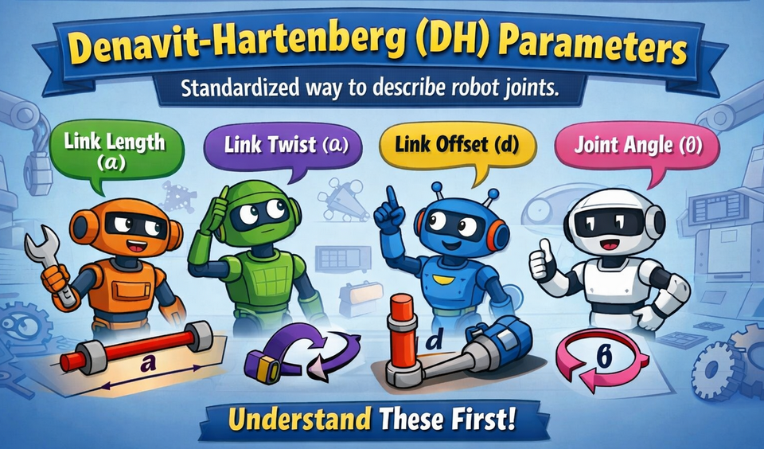
Forward Kinematics
Before moving to Homogeneous Transformations Process, we should know about first

Slide 6
D-H Parameter Calculation
z1
z2
Link
x1
x2
J1
J2
Links are required to figure out the joints. All calculations are done using the axes of the joint.
z1
z2
x1
x2
J1
J2
For each joint, we have 4 parameters.

Slide 7
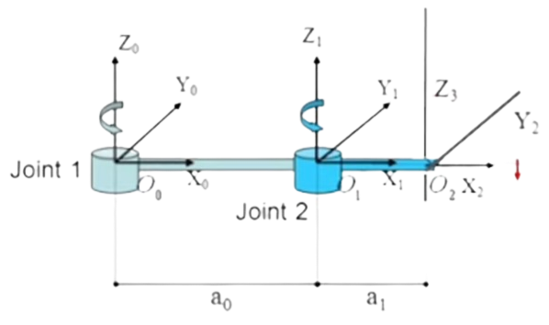
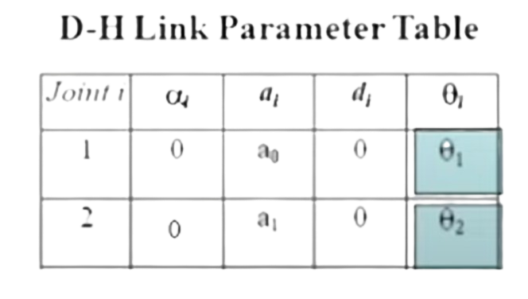
Link Parameters and Joint Variables
  Special parameters that helps express the structure or anatomy of the manipulator
  One manipulator has total four parameters:
  - two angular parameters: α (alpha), θ (theta)
  - two linear parameters: d, a

Slide 8
Definition of the Four Parameters
Link Length (a_{i}): Distance between z_{i-1} and z_{i} along x_{i}
Link Twist (𝝰_{i}): Angle between z_{i-1} and z_{i} about x_{i}
Joint Offset (d_{i}): Distance between x_{i-1} and x_{i} along z_{i-1}
Joint Angle (Ө_{i}): Angle between x_{i-1} and x_{i} about z_{i-1}
Note: Don’t try to imagine the Y-axis
https://www.youtube.com/watch?v=rA9tm0gTln8

Slide 9
Link Length (a_{i})
Distance between z_{i-1} and z_{i} along x_{i}
Z_{i}
Z_{i-1}
x_{i-1}
x_{i}
If you start walking, starting from z_{i-1} to z_{i}, using the road x_{i} What will be the distance?

Slide 10
Link Length (a_{i})
Distance between z_{i-1} and z_{i} along x_{i}
a_{i}
Z_{i}
Z_{i-1}
x_{i-1}
x_{i}
The black line is that distance. Very Easy Right !!!
Now let’s make the second frame rotate.

Slide 11
Link Length (a_{i})
Distance between z_{i-1} and z_{i} along x_{i}
a_{i}
Z_{i}
Z_{i-1}
x_{i-1}
x_{i}
Now a_{i} is not the link length, why??

Slide 12
Link Length (a_{i})
Distance between z_{i-1} and z_{i} along x_{i}
a_{i}
Z_{i}
Z_{i-1}
x_{i-1}
x_{i}
Here the you are not walking along x_{i} axis to reach z_{i} instead y_{i} axis.
In this example, there is no distance between z axis along x_{i} axis.
a_{i} = 0

Slide 13
Link Length (a_{i})
Distance between z_{i-1} and z_{i} along x_{i}
Here, you can see the a_{i} distance is alone x_{i} axis.
Z_{i-1}
a_{i}
x_{i-1}
Z_{i}
x_{i}

Slide 14
Link Length (a_{i})
Distance between z_{i-1} and z_{i} along x_{i}
Confusion: You may get confused about the Red line distance. This line actually the moving along y_{i} axis. That’s why according to the the definition that will not the Link length.
Z_{i-1}
a_{i}
x_{i-1}
Z_{i}
y_{i}
x_{i}

Slide 15
Joint Offset (d_{i})
Z_{i}
Distance between x_{i-1} and x_{i} along z_{i-1}
If you start walking, starting from x_{i-1} to x_{i}, using the road z_{i-1} What will be the distance?
x_{i}
Z_{i-1}
x_{i-1}

Slide 16
Joint Offset (d_{i})
Z_{i}
Distance between x_{i-1} and x_{i} along z_{i-1}
The black line is that distance. As the distance start from x_{i-1} to x_{i} along in the direction of z_{i-1}
x_{i}
d
Z_{i-1}
x_{i-1}

Slide 17
Joint Offset (d_{i})
Distance between x_{i-1} and x_{i} along z_{i-1}
Z_{i}
Z_{i-1}
x_{i-1}
x_{i}
Here d_{i} = 0. Why???

Slide 18
Link Twist (𝝰_{i}):
Angle between z_{i-1} and z_{i} about x_{i}
Z_{i}
Z_{i-1}
x_{i-1}
x_{i}
When you rotate the the second frame about x_{i} , there is an angle between z_{i-1} and z_{i}.

Slide 19
Link Twist (𝝰_{i}):
Angle between z_{i-1} and z_{i} about x_{i}
Z_{i}
Z_{i-1}
ɑ_{i}
Z_{i-1}
x_{i-1}
x_{i}
When you rotate the the second frame about x_{i} , there is an angle between z_{i-1} and z_{i}.

Slide 20
Link Twist (𝝰_{i}):
Angle between z_{i-1} and z_{i} about x_{i}
Z_{i}
Z_{i-1}
x_{i-1}
x_{i}
Here the 𝝰_{i} = -90º.

Slide 21
Link Twist (𝝰_{i}):
Angle between z_{i-1} and z_{i} about x_{i}
Z_{i-1}
x_{i-1}
x_{i}
Z_{i}
Here the 𝝰_{i} = +90º.
Why???

Slide 22
Joint Angle (Ө_{i})
Angle between x_{i-1} and x_{i} about z_{i-1}
Z_{i}
Z_{i-1}
x_{i}
x_{i-1}
When you rotate the the second frame about z_{i-1} , there is an angle between x_{i-1} and x_{i}.

Slide 23
Joint Angle (Ө_{i})
Angle between x_{i-1} and x_{i} about z_{i-1}
Z_{i}
Z_{i-1}
x_{i}
Ө_{i}
x_{i-1}
x_{i-1}
When you rotate the the second frame about z_{i-1} , there is an angle between x_{i-1} and x_{i}.
Here the Ө_{i} is the joint angle and it is positive (CCW)

Slide 24
Joint Angle (Ө_{i})
Angle between x_{i-1} and x_{i} about z_{i-1}
Z_{i}
Z_{i-1}
x_{i-1}
x_{i-1}
Ө_{i}
x_{i}
Now Ө_{i} is negative. Why???

Slide 25
Example-1

Slide 26
DH Table
P (x,y)
X₃
Steps:
Identify Joints and Links
Assign a coordinate frame to each link
For each joint, calculate the four D-H parameters: 𝛼 , a​ , d and θ (joint type mentioned in the question).
Construct DH Table
X₁
L₃
θ₃
Y₀
θ₂
X₂
L₂
Z₂
L₁
Z₁
θ₁
X₀
3R Planar Robot
Z₀

Slide 27
DH Table
P (x,y)
X₃
X₁
L₃
θ₃
i | Ө_{i} | a_{i} | d_{i} | 𝝰_{i}
1
2
3
Y₀
θ₂
X₂
L₂
Z₂
L₁
Z₁
θ₁
X₀
3R Planar Robot
Z₀

Slide 28
DH Table
P (x,y)
X₃
X₁
L₃
θ₃
i | Ө_{i} | a_{i} | d_{i} | 𝝰_{i}
1 | +Ө₁
2 | -Ө₂
3 | +Ө₃
Y₀
θ₂
X₂
L₂
Z₂
L₁
Z₁
θ₁
X₀
3R Planar Robot
Z₀

Slide 29
DH Table
P (x,y)
X₃
X₁
L₃
θ₃
i | Ө_{i} | a_{i} | d_{i} | 𝝰_{i}
1 | +Ө₁ | L₁
2 | -Ө₂ | L₂
3 | +Ө₃ | L₃
Y₀
θ₂
X₂
L₂
Z₂
L₁
Z₁
θ₁
X₀
3R Planar Robot
Z₀

Slide 30
DH Table
P (x,y)
X₃
X₁
L₃
θ₃
i | Ө_{i} | a_{i} | d_{i} | 𝝰_{i}
1 | +Ө₁ | L₁ | 0
2 | -Ө₂ | L₂ | 0
3 | +Ө₃ | L₃ | 0
Y₀
θ₂
X₂
L₂
Z₂
L₁
Z₁
θ₁
X₀
3R Planar Robot
Z₀

Slide 31
DH Table
P (x,y)
X₃
X₁
L₃
θ₃
i | Ө_{i} | a_{i} | d_{i} | 𝝰_{i}
1 | +Ө₁ | L₁ | 0 | 0
2 | -Ө₂ | L₂ | 0 | 0
3 | +Ө₃ | L₃ | 0 | 0
Y₀
θ₂
X₂
L₂
Z₂
L₁
Z₁
θ₁
X₀
3R Planar Robot
Z₀

Slide 32
Example-2

Slide 33
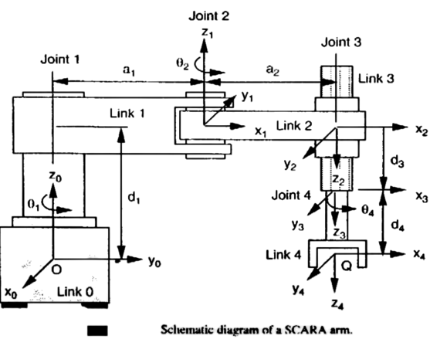
D-H Parameters for SCARA Robot
Steps:
Identify Joints and Links
Assign a coordinate frame to each link
For each joint, calculate the four D-H parameters: 𝛼 , a​ , d and θ (joint type mentioned in the question).
Construct DH Table

Slide 34
D-H Parameters for SCARA Robot
2
3
D-H Parameter Table
Joint | α | a | d | θ
1
2
3
4
4
1

Slide 35
D-H Parameters for SCARA Robot
For joint 1
D-H Parameter Table
2
Joint | α | a | d | θ
1 | 0 | a₁ | d₁ | θ₁
2
3
4
3
4
1

Slide 36
D-H Parameters for SCARA Robot
For joint 2
D-H Parameter Table
2
Joint | α | a | d | θ
1 | 0 | a₁ | d₁ | θ₁
2 | 180 | a₂ | 0 | θ₂
3
4
3
4
1

Slide 37
D-H Parameters for SCARA Robot
For joint 3
D-H Parameter Table
2
Joint | α | a | d | θ
1 | 0 | a₁ | d₁ | θ₁
2 | 180 | a₂ | 0 | θ₂
3 | 0 | 0 | d₃ | 0
4
3
4
1

Slide 38
D-H Parameters for SCARA Robot
For joint 4
D-H Parameter Table
2
Joint | α | a | d | θ
1 | 0 | a₁ | d₁ | θ₁
2 | 180 | a₂ | 0 | θ₂
3 | 0 | 0 | d₃ | 0
4 | 0 | 0 | d₄ | θ₄
3
4
1

Slide 39
EXTRAS

Slide 40
1. α (Link Twist / Twist Angle)
- Angle between two z-axes of the two consecutive joints about the x-axis
Examples:
z1
x2
i) α = - 90 deg
J1
x1
J2
z2
Explanation:
- For calculating α for a joint (j1), we need z-axis of the next joint (j2).
- Simply figure out the angle between the z-axes of the two joints
z1
- If movement clockwise, angle negative
- If movement anti-clockwise, angle positive
-90°
z2

Slide 41
Examples:
z2
z1
z2
ii)
z1
Angle: 0°
J1
x1
J2
x2
z1
x2
iii)
z2
z2
J2
Angle: 90°
J1
x1
x2
J2

Slide 42
2. a (Link Length)
Distance between two consecutive joint axes along the x-axis of the i-th co-ordinate frame
Towards the x-axis of the second joint
z1
z2
Examples:
x1
x2
i)
J1
J2
a
z2
ii)
x2
z1
J2
a
x1
J1

Slide 43
Examples:
a = 0
z1
x2
iii)
No distance between the axes
x1
z2
J1
J2
iv)
x2
z1
z2
J2
a
x1
J1

Slide 44
3. d (Link Offset)
Distance along the z-axis from the previous link to the next link
Towards the z-axis of the first joint
z2
Examples:
z1
i)
x2
J2
d
x1
J1
ii)
z1
x2
d = 0
a = 0
x1
z2
J1
J2

Slide 45
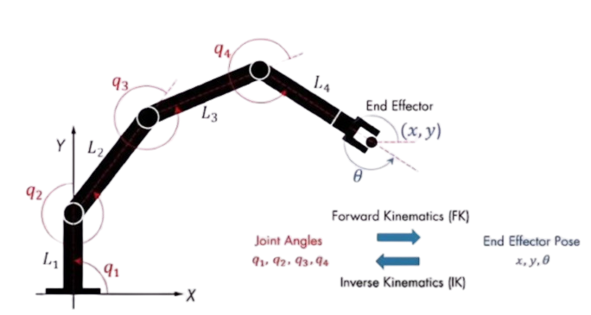
4. θ (Joint Angle)
Angle of rotation around the z-axis needed to align with the x-axis of the previous link with the x-axis of the current link
For passive joints, θ = 0 degree.
For active joints, if prismatic: θ = 0 degree
      if revolute: θ = degree mentioned for the joint
Example:

